Slide 1

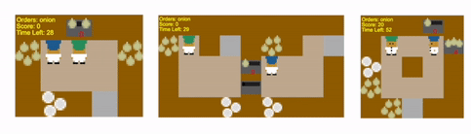
Overcooked Experiments
University of Bologna
Autonomous and Adaptive Systems
- Exam Project
Tommaso Perniola mat: 0001146230

Slide 2
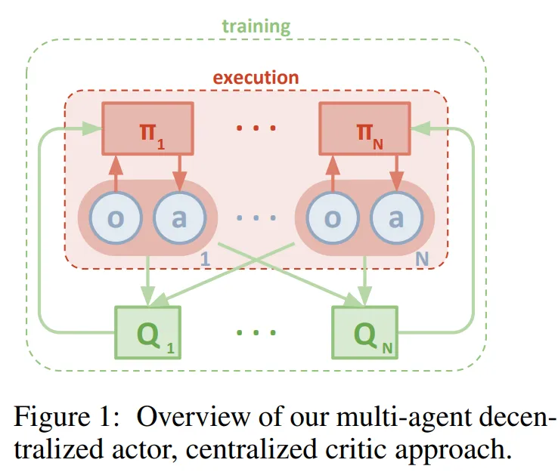
My approach MAPPO + CTDE
Stable learning: centralized critic sees the joint state, reducing non-stationarity.
Clearer credit assignment: critic provides a global signal while actors learn from local views.
Scalable & efficient: decentralized actors share one policy, complexity grows linearly with #agents.
Cooperation emerges: agents coordinate without fixed roles or persistent identities.

Slide 3
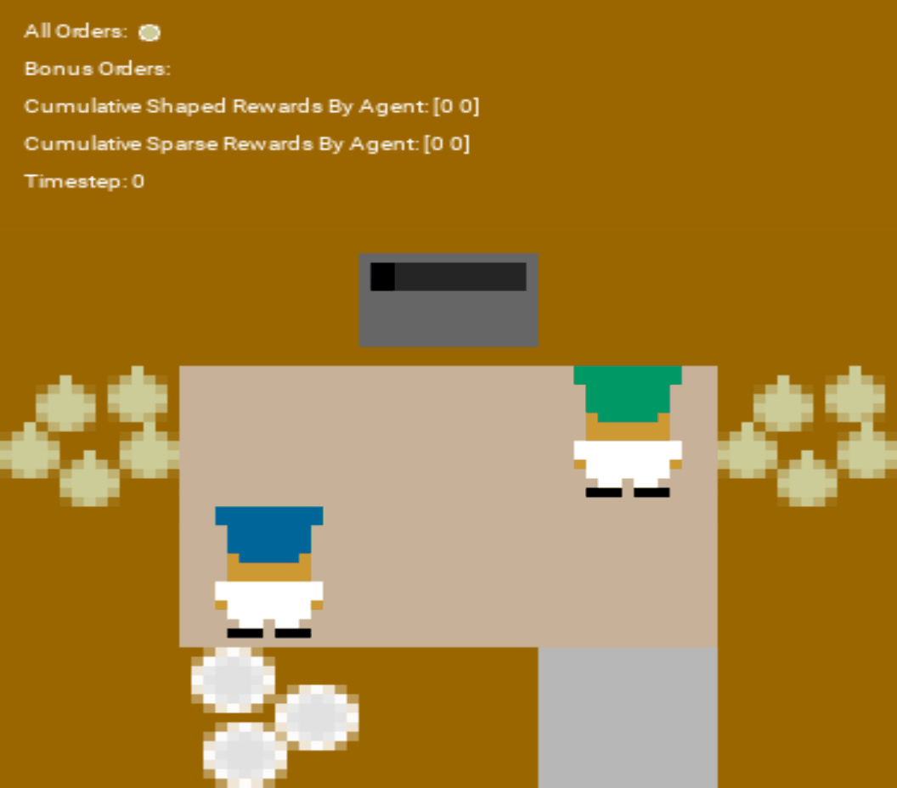
GIFs: Cramped Room only model
This first GIF shows the learning process in a single-layout setting, trained over 40 rollouts. The resulting behavior is close to optimal, with only occasional “pauses”. Interestingly, the agents also appear to have developed implicit roles: one primarily handles cooking, while the other focuses on delivery.
v2: multi-layout training
This second GIF illustrates training in a multi-layout setting. The agents again achieve near-optimal behavior, but the cumulative sparse rewards are more evenly distributed between them. Unlike in the single-layout case—where one agent primarily cooked—they now adopt a turn-taking strategy, sharing both cooking and delivery. This shift emerges because the model has learned to exploit the coordination patterns required by the more complex layouts.
v1: single-layout training

Slide 4
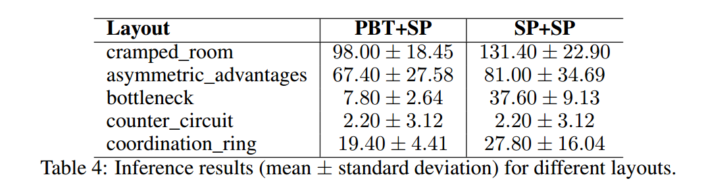
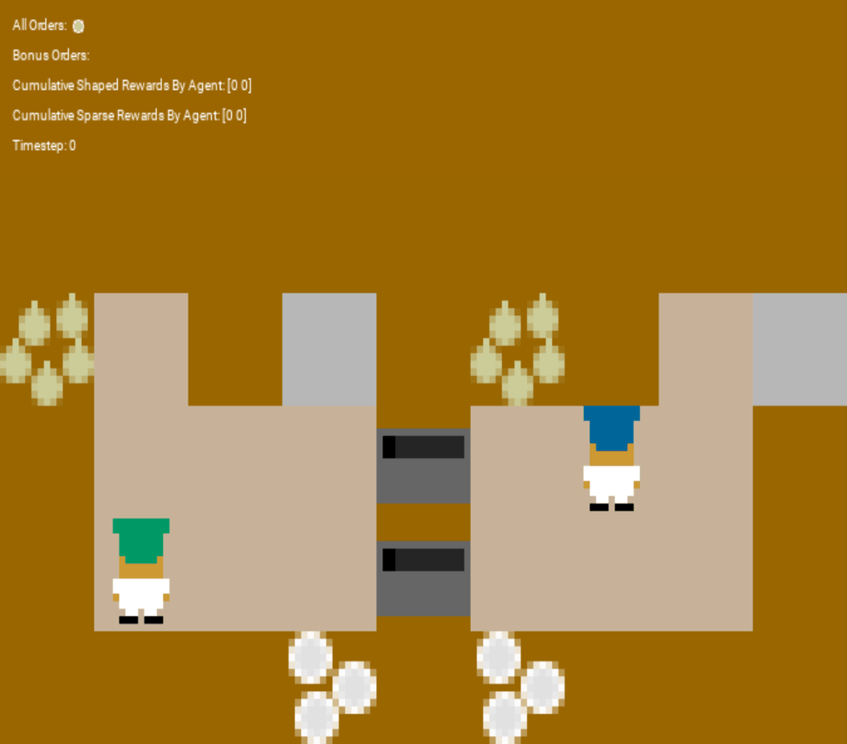
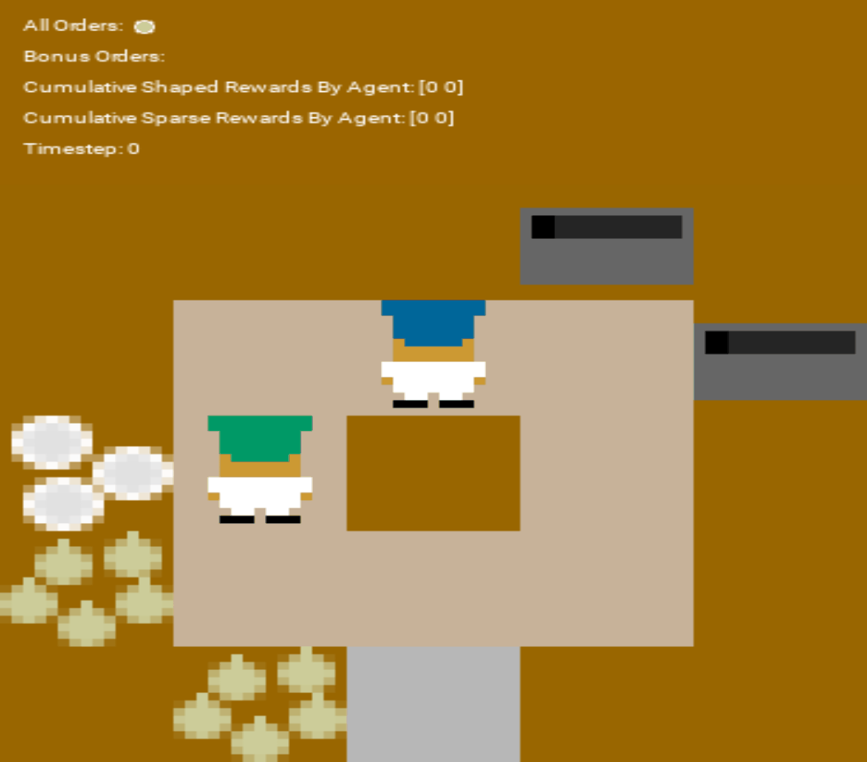
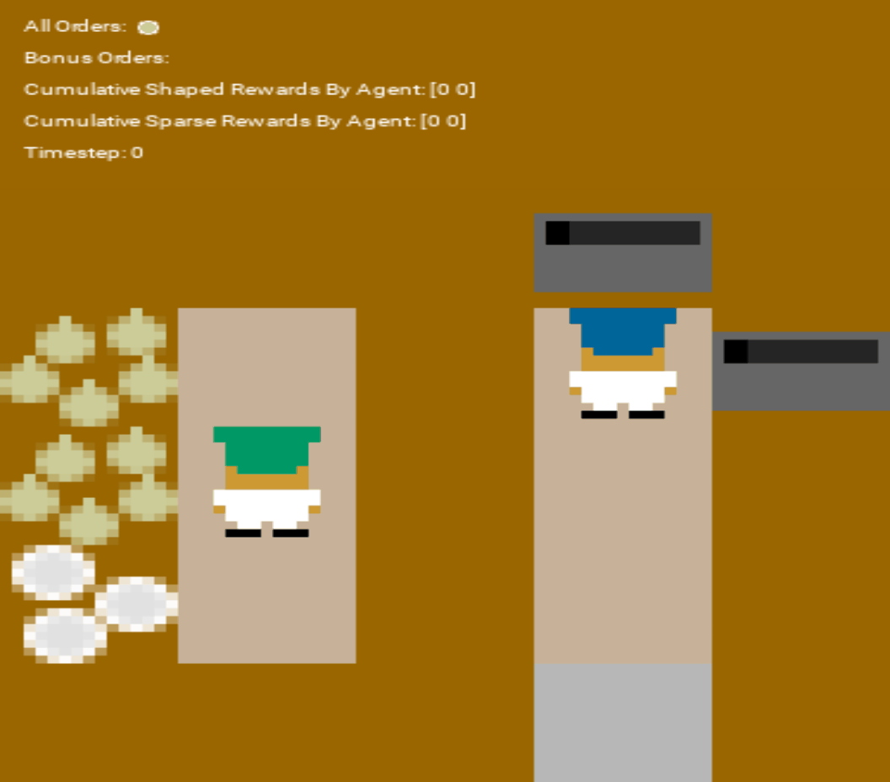
GIFs + results: Other layouts with final models
Asymmetric advantages (SP)
Coordination Ring (SP)
[unseen] Forced coord. (SP)
The gif highlights clear collaborative behavior between the two agents: they manage to deliver three valid dishes, although their choices are still suboptimal (e.g., cooking with only one or two onions)
The gif highlights glimpses of collaboration, but the difficulty of the layout limits overall performance. The agents also appear somewhat confused about the delivery task.
The gif shows that, even in an unseen layout requiring strong collaboration, the agents achieve a reward of 17 by placing several onions and taking dishes — although these remain fairly common behaviors.

